Slide 1
Chapter 11.03: Fourier Transform Pair: Frequency and Time Domain
Lecture # 5
by
Dr. Md. Rajibul Islam
CSE, UAP

Slide 2
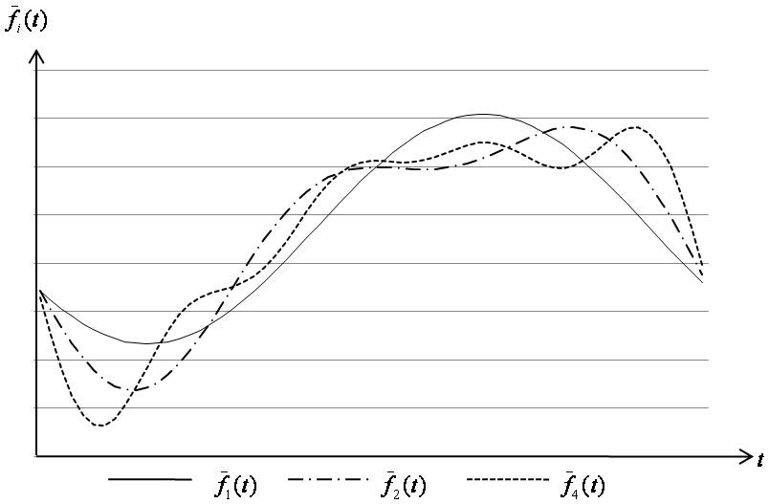
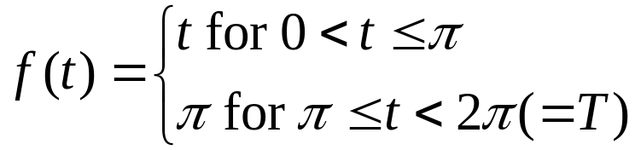
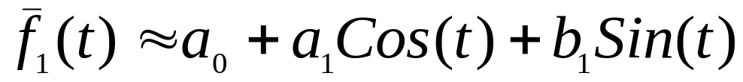
Example 1

Slide 3
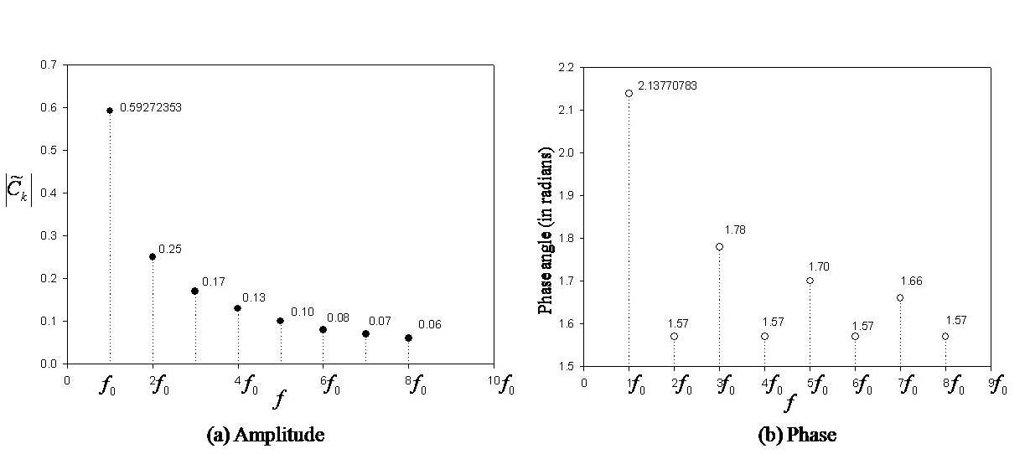
Frequency and Time Domain
The amplitude (vertical axis) of a given periodic function
can be plotted versus time (horizontal axis), but it can
also be plotted in the frequency domain as shown in
Figure 2.
Figure 2 Periodic function (see Example 1 in Chapter 11.02 Continuous Fourier Series) in frequency domain.

Slide 4
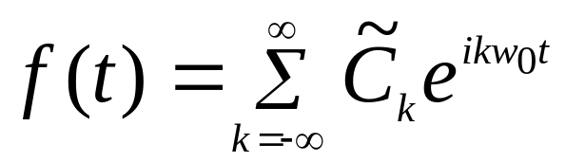
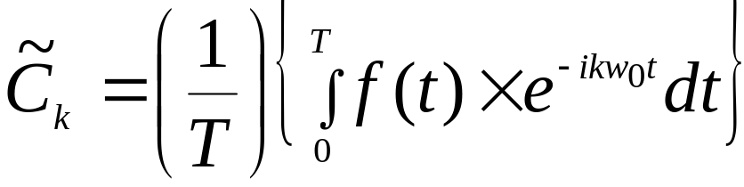
Frequency and Time Domain cont.
Figures 2(a) and 2(b) can be described with the following equations from chapter 11.02,
(39, repeated)
where
(41, repeated)

Slide 5
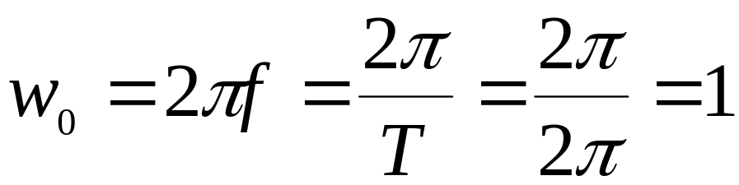
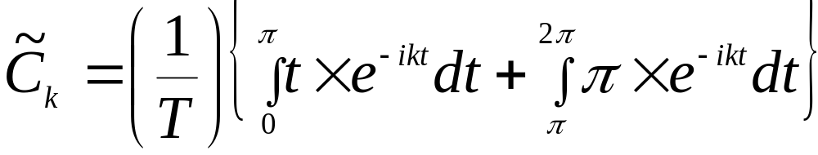
Frequency and Time Domain cont.
For the periodic function shown in Example 1 of Chapter 11.02 (Figure 1), one has:

Slide 6
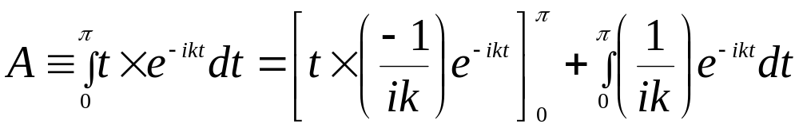
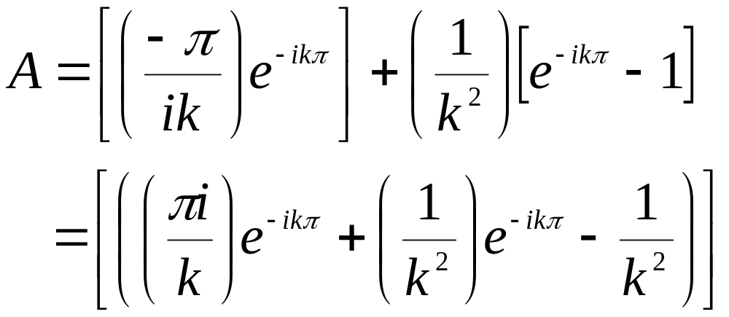
Frequency and Time Domain cont.
Define:
or

Slide 7
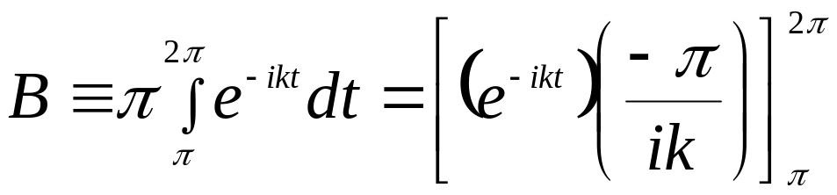
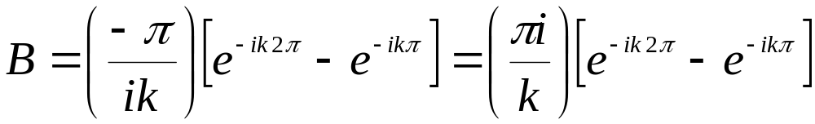
Frequency and Time Domain cont.
Also,

Slide 8
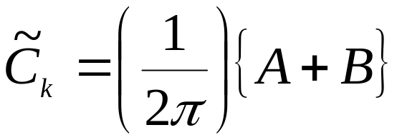
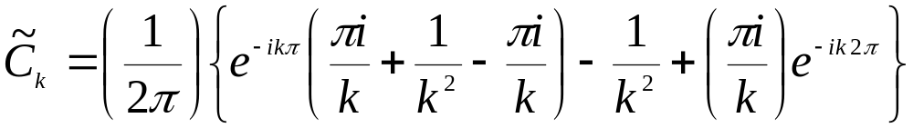
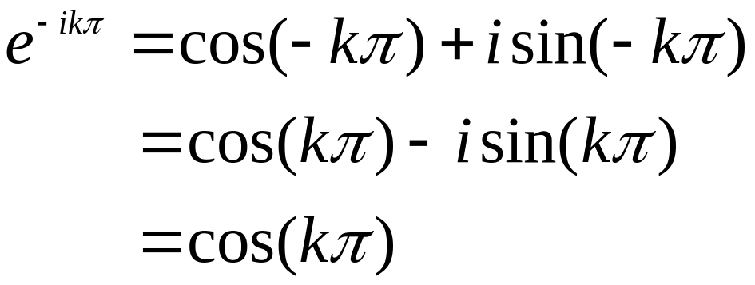
Frequency and Time Domain cont.
Thus:
Using the following Euler identities

Slide 9
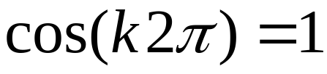

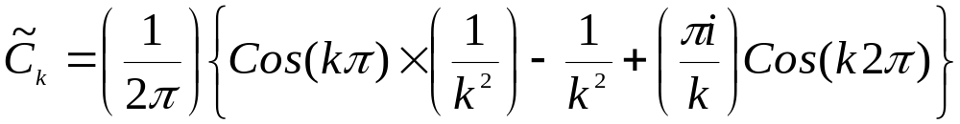
Frequency and Time Domain cont.
Noting that
for any integer
1

Slide 10
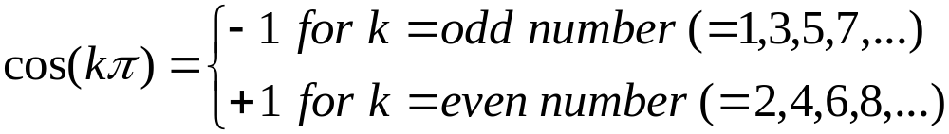
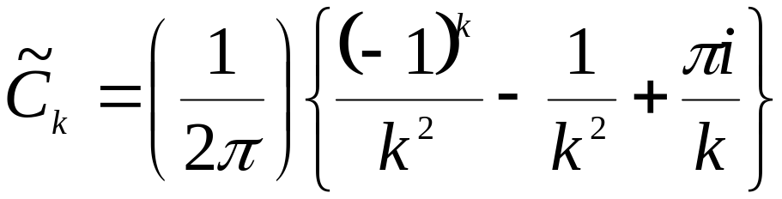
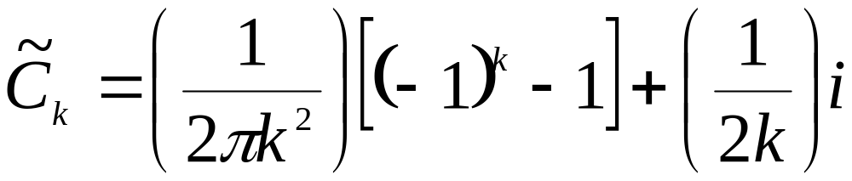
Frequency and Time Domain cont.
Also,
Thus,

Slide 11
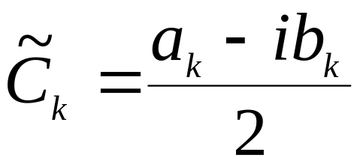
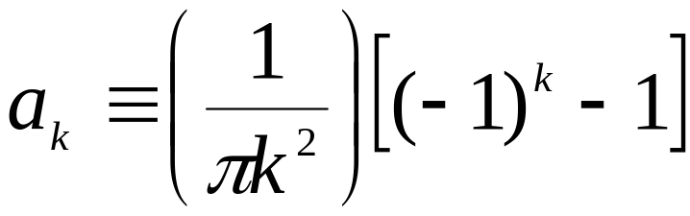
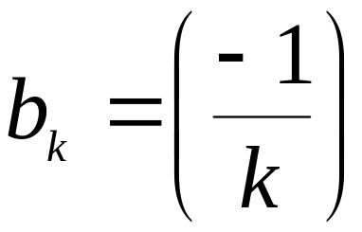
Frequency and Time Domain cont.
From Equation (36, Ch. 11.02), one has
(36, repeated)
Hence; upon comparing the previous 2 equations, one concludes:

Slide 12
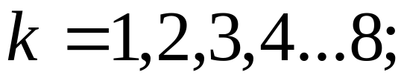
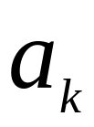

Frequency and Time Domain cont.
For
the values for
and
(based on the previous 2 formulas) are exactly
identical as the ones presented earlier in Example
1 of Chapter 11.02.

Slide 13
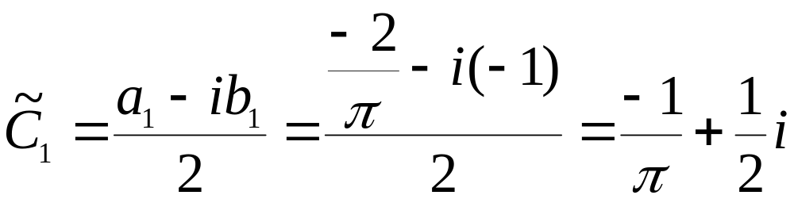
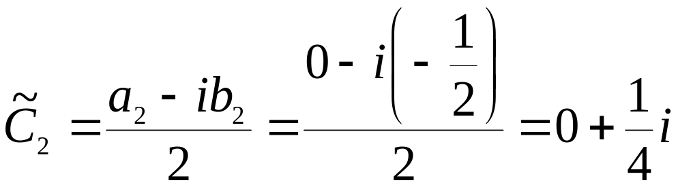
Frequency and Time Domain cont.
Thus:

Slide 14
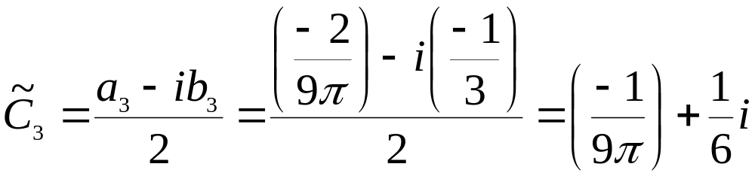
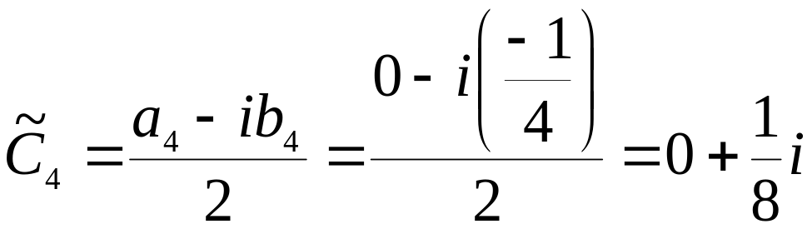
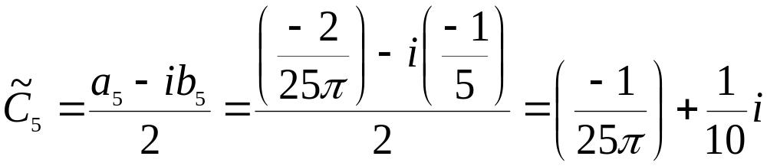
Frequency and Time Domain cont.

Slide 15
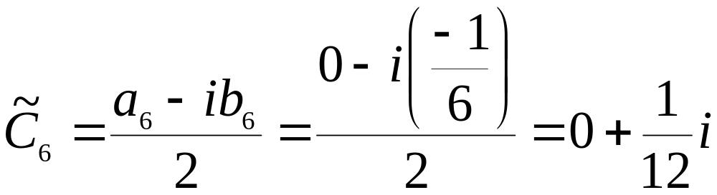
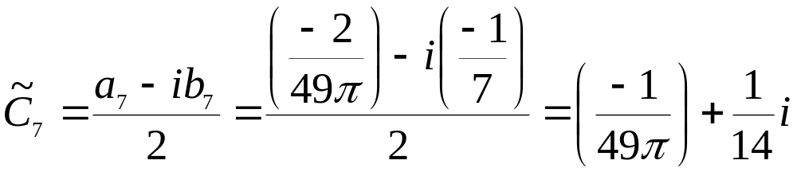
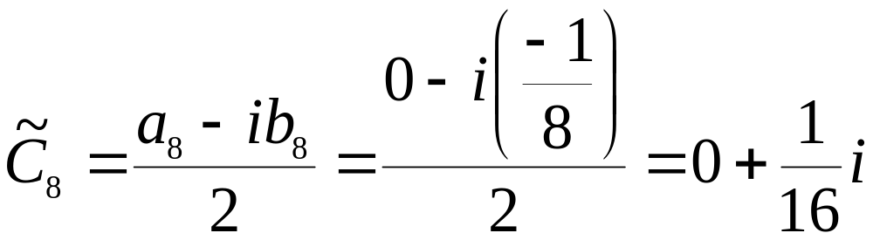
Frequency and Time Domain cont.

Slide 16
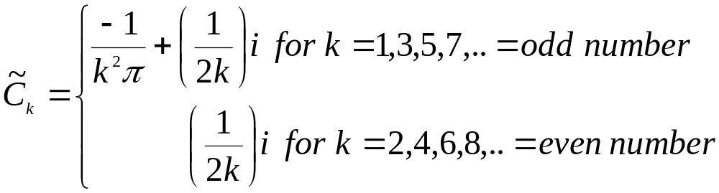
Frequency and Time Domain cont.
In general, one has

Slide 17
THE END

Slide 18
Acknowledgement
This instructional power point brought to you by
Numerical Methods for STEM undergraduate
http://numericalmethods.eng.usf.edu
Committed to bringing numerical methods to the undergraduate

Slide 19
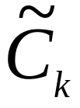
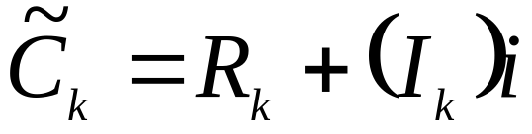
Chapter 11.03: Complex number in polar coordinates (Contd.)
Lecture # 6
In Cartesian (Rectangular) Coordinates, a complex number can be expressed as:
In Polar Coordinates, a complex number can be expressed as:

Slide 20
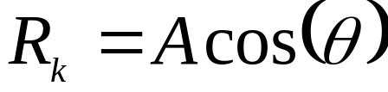
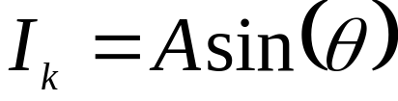
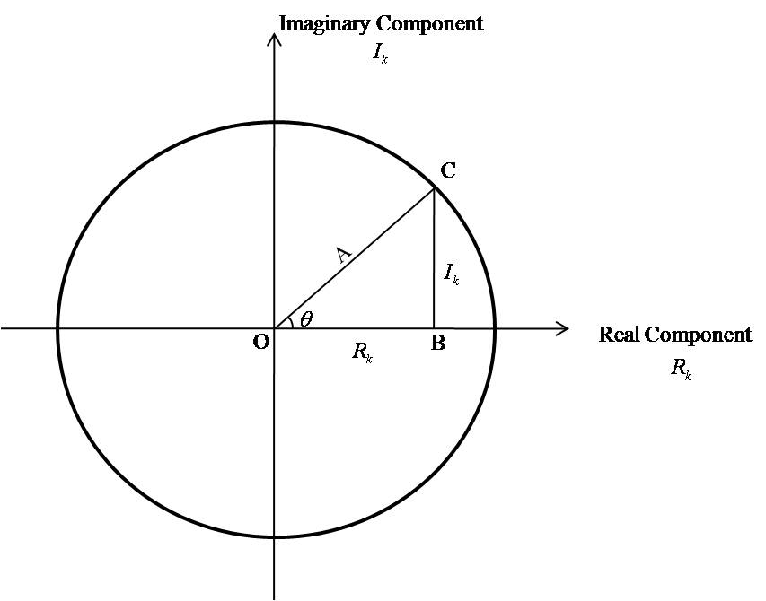
Complex number in polar coordinates cont.
Thus, one obtains the following relations between the Cartesian and polar coordinate systems:
This is represented graphically in Figure 3.
Figure 3. Graphical representation of the complex number system in polar coordinates.

Slide 21
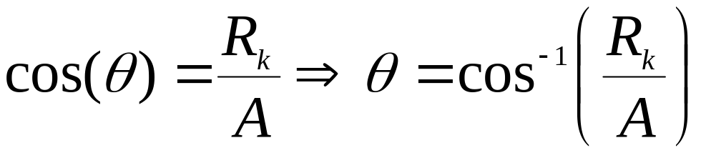
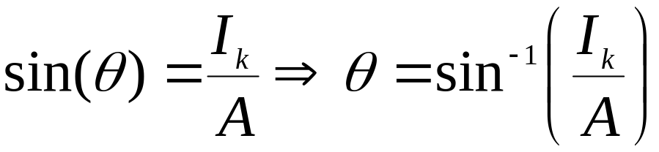
Complex number in polar coordinates cont.
Hence
and

Slide 22

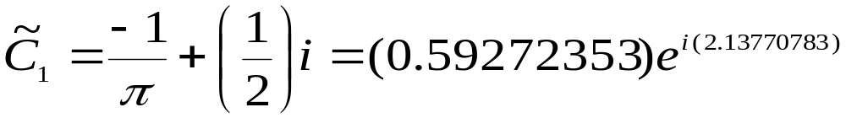
Complex number in polar coordinates cont.
Based on the above 3 formulas, the complex numbers
can be expressed as:

Slide 23




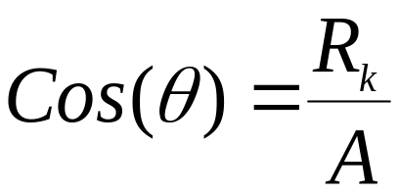
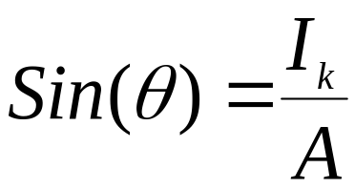
Complex number in polar coordinates cont.
Notes:
The amplitude and angle are 0.59 and
2.14 respectively (also see Figures 2a, and
2b in chapter 11.03).
(b) The angle (in radian) obtained from
will be 2.138 radians (=122.48º).
However based on
Then = 1.004 radians (=57.52º).

Slide 24
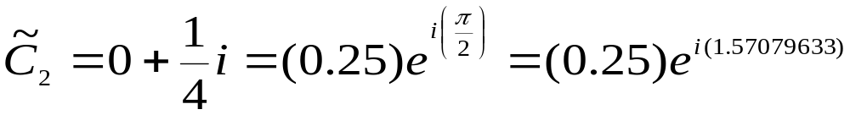
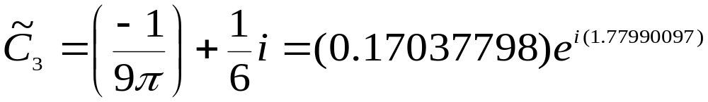
Complex number in polar coordinates cont.
Since the Real and Imaginary components of are
negative and positive, respectively, the proper selection
for should be 2.1377 radians.

Slide 25
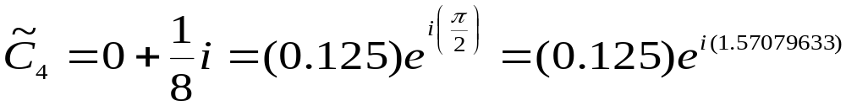
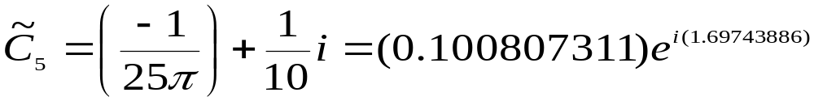
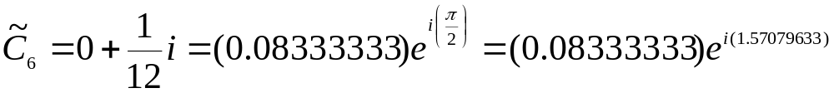
Complex number in polar coordinates cont.

Slide 26
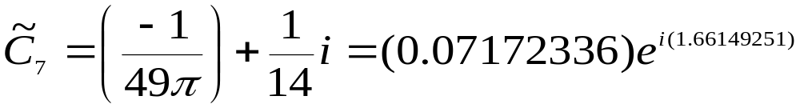

Complex number in polar coordinates cont.

Slide 27
THE END

Slide 28
Acknowledgement
This instructional power point brought to you by
Numerical Methods for STEM undergraduate
http://numericalmethods.eng.usf.edu
Committed to bringing numerical methods to the undergraduate

Slide 29


Chapter 11. 03: Non-Periodic Functions (Contd.)
Lecture # 7
Recall
(39, repeated)
(41, repeated)
Define
(1)

Slide 30




Non-Periodic Functions
Then, Equation (41) can be written as
And Equation (39) becomes
From above equation
or

Slide 31




Non-Periodic Functions cont.
From Figure 4,
Figure 4. Frequency are discretized.

Slide 32



Non-Periodic Functions cont.
Multiplying and dividing the right-hand-side of the
equation by , one obtains
; inverse Fourier
transform
Also, using the definition stated in Equation (1), one gets
; Fourier transform

Slide 33
THE END

Slide 34
Acknowledgement
This instructional power point brought to you by
Numerical Methods for STEM undergraduate
http://numericalmethods.eng.usf.edu
Committed to bringing numerical methods to the undergraduate

